Slide 1


Do you know what is the current status of your assets…?
What do you own..??
Where is it..??
What condition is it on..??
What is its remaining useful years..??
To subscribe please visit : http://myassetonline.in/

Slide 2




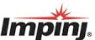
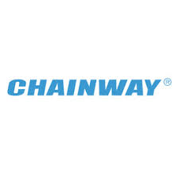
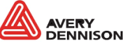

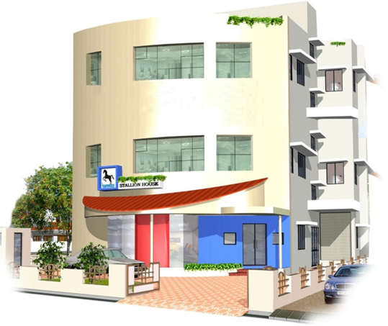
Headquartered in Kochi, Kerala, one of India’s leading IT hub
Wide reach with a nationwide network of 16 direct branch offices
International operations in UAE, Qatar & Oman
STALLION Highlights
About
Launched 2 decades ago, Stallion is a premium vendor in the AIDC industry providing solutions in India & Middle East.
  Tailor made solutions as per customer requirements in AIDC technologies like Barcode & RFID
  Wide range of cost effective RFID infrastructure
  Over 20000 privileged customers
  Manufacturing units at Kochi, Bangalore, Mumbai & Dubai (UAE) for tags & consumables
  POS terminals for Retail industry
  Proven track record in providing Warehouse, Asset & Inventory management solutions
  Document Archiving Solutions
  Solutions for Manufacturing Assembly Lines
  HR Real time monitoring Attendance Systems
  IT Asset Management Solutions
To subscribe please visit : http://myassetonline.in/

Slide 3

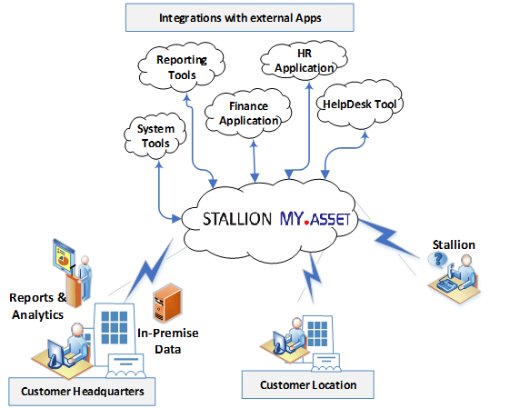
KEY FEATURES
    Available in SaaS model. As subscription model my.asset can be used
    Proven and powerful Asset Management Tool
    Web-based UI – access any time, any location.
    Low cost of scaling and quick ROI
    Supports Barcode & RFID. Wide variety of hardware and tags available from Stallion.
    Asset Details – Category, Details, Location, Owner, Status, Metadata and much more.
    Rich set of reports. Customized reports based on user requirements.
    Integrations based on API / Webservices
    Maintenance scheduling and tracking
    AMC & Insurance tracking
To subscribe please visit : http://myassetonline.in/

Slide 4









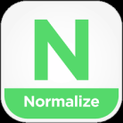














PROCESS FLOW
Master Data
ASSET IN
ASSET LIFECYCLE
COUNT
DISPOSAL
Input Source
Issue
Update Owner
Asset Count
Scrap List
Location
Assets / GRN
Maintenance
Identify Conditions
Tagging/Bar Coding
GRNs
Normalize Count
Items
Inter-Branch Transfer
Approvals
ERP / Financials
Tagging/Bar Coding
ADD ONS
Disposal Policies & Methods
Warranty & Insurance
HR
Asset Transfer
Report & Post
Update Owner
Host Systems Integration
Inventory
Helpdesk Solutions
Approvals
LDAP
Reconciliation
Postings

Slide 5
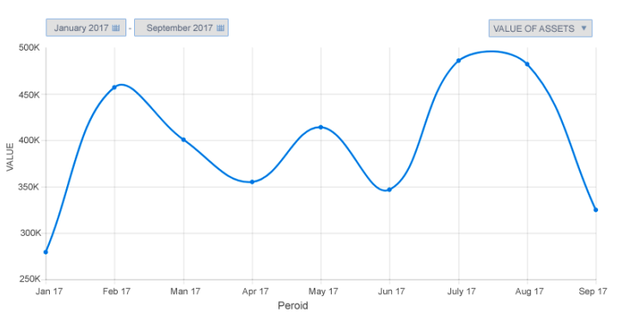
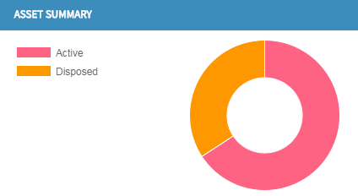
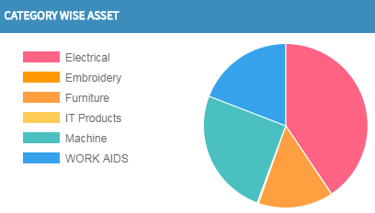
REPORT & DASHBOARDS
    Extensive built-in Reports
    Export to XLS for flexibility
    Alerts & Notifications
    Integration Option to Reporting / BI Tools
    Customized Reports if Required
    Alerts & Notifications
      Reminder on Expiry date of AMC for all Assets
      Reminder on Expiry date of Warranty for all Assets
    Reports -
      Purchase Request Report
      Purchase Order Report
      Report on GRN
      Asset Details
      Asset History
      Asset Register
      Asset Summary
      Employee wise Asset Details
      Vendor wise Asset Details
      Barcode wise Asset Details
      Report on Transfer of Assets
      Report on Pending Calls
      Report on Service/Standby
      Report on Scrap
      Report on Depreciation
      Insurance and Claim Details
      Physical Verification Report.

Slide 6






KEY BENEFITS
Accurate Asset Data
The asset data will be highly accurate with the most recent physical status available for each asset.
Better Control Over Assets
By capturing Location, Owner, Custodian and User information for each asset, My.Asset ensures high level of accountability and accurate asset data.
Efficient Asset Audit
The time, money and efforts spent on asset audit reduces significantly and the physical information collected during audit is updated real-time and is highly accurate.
Better Procurement Decisions
By knowing what assets are unused, where they are and who has them, better procurement decisions can be made.
True and Fair Reporting
The fixed assets reporting in financial statements and other reports is true and fair as accurate physical information is available.
Reduced Tax Liabilities
By timely providing for/writing off assets that you no longer have or are obsolete or are unused, the overall tax liability reduces. Asset register with depreciated value can be generated in few clicks
To subscribe please visit : http://myassetonline.in/

Slide 7

MARQUEE CLIENTS
Asset Management Solution
Government of India
State Government Organizations
Private sector
Hospitality
Health Care
Hi-value Organizations
To subscribe please visit : http://myassetonline.in/

Slide 8
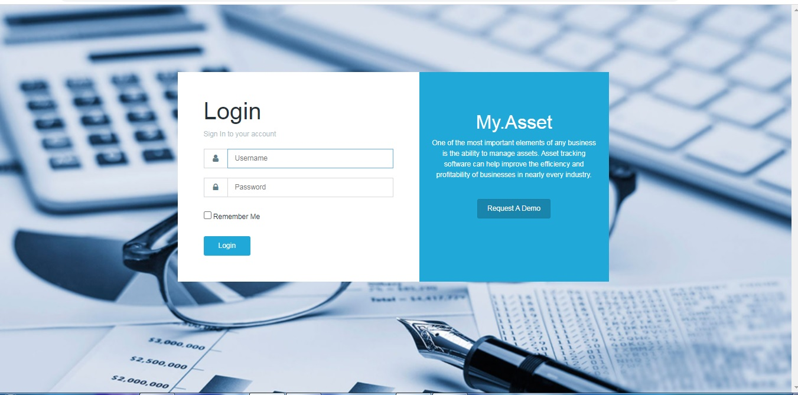
SNAPS FROM MY ASSET
To subscribe please visit : http://myassetonline.in/

Slide 9
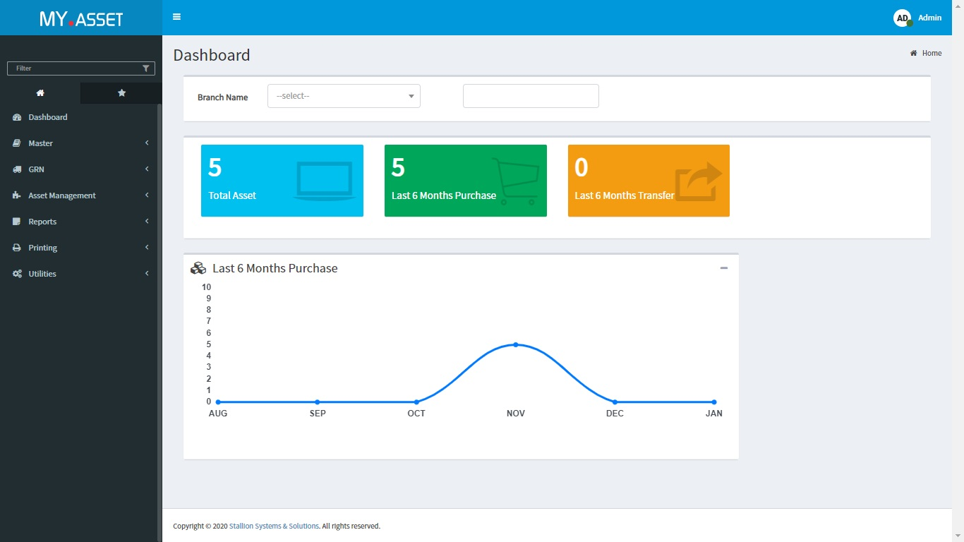
SNAPS FROM MY ASSET
To subscribe please visit : http://myassetonline.in/

Slide 10
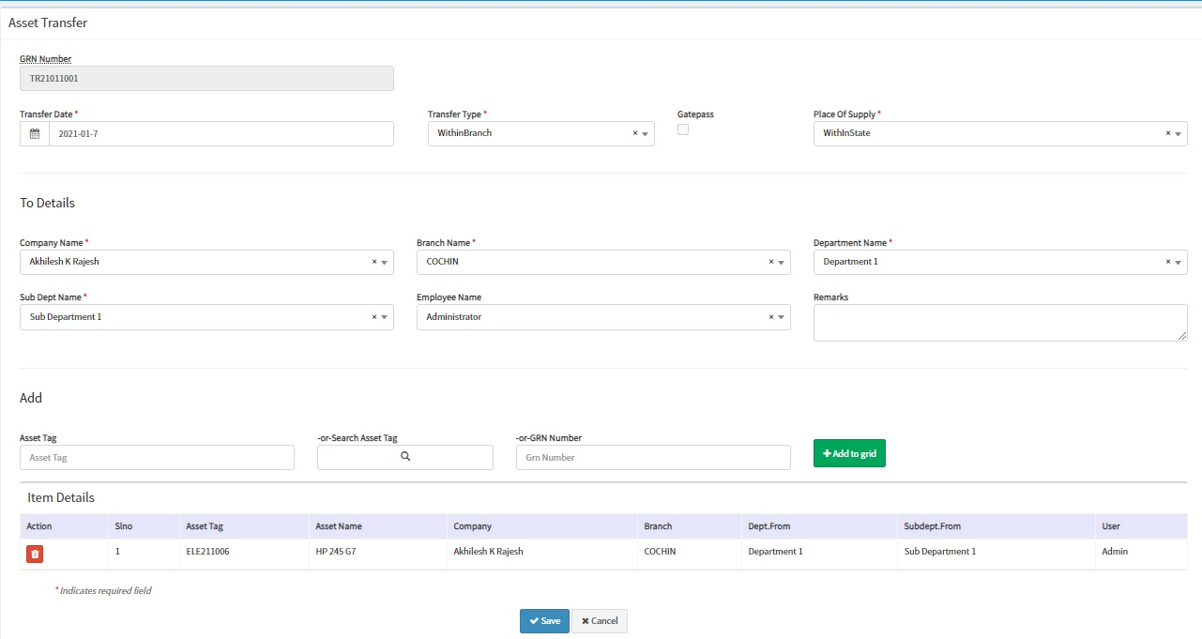
SNAPS FROM MY ASSET
To subscribe please visit : http://myassetonline.in/

Slide 11
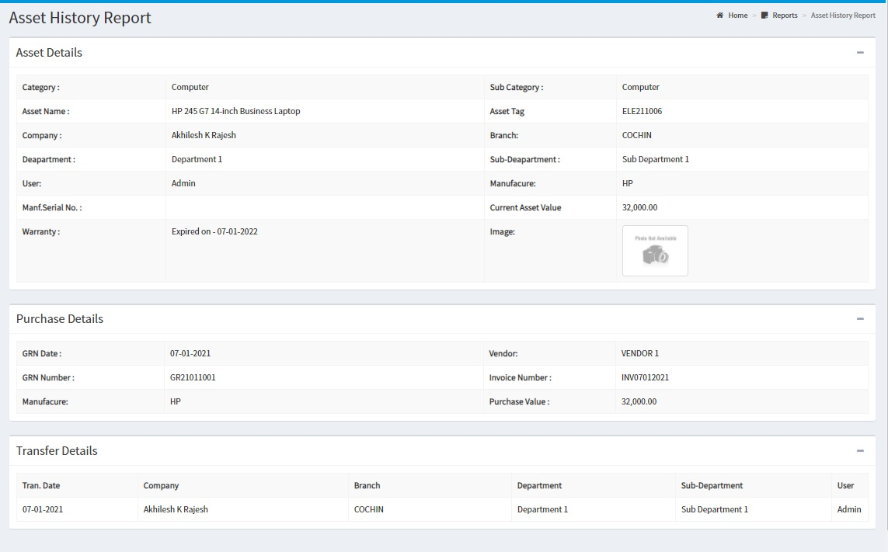
SNAPS FROM MY ASSET
To subscribe please visit : http://myassetonline.in/

Slide 12

To subscribe please visit : http://myassetonline.in/

